Slide 1



Department of Computer Science and Engineering
Voice Controlled Smart Home For Disabled People
Rakshinee.H Rajasri.R
211423104518
211423104514
Guide Name & Designation:
Mr.Ramana .R
Coordinator Name & Designation:
Dr. C. Elangovan
1

Slide 2
Abstract
Software-based Smart Home System for differently-abled individuals
Uses voice commands & accessible GUI
Enhances independence, safety, and comfort
Integrates voice recognition, accessibility modules & emergency alerts
Aligns with UN SDG 3 – Good Health & Well-Being
2

Slide 3
Introduction
Many disabled individuals depend on caregivers for daily tasks
Traditional smart homes lack inclusivity
Aim: provide voice-based & accessible control
Focus on mobility, visual, and hearing impairments
Promotes independent living and safety

Slide 4
Objective
Develop voice-controlled smart home system
Design accessible user interface
Integrate emergency alert mechanism
Ensure low cost & scalability
Improve quality of life & inclusivity

Slide 5
Literature Survey
S.No | Author(s) | Title | Year | Method/Outcome
1 | M.A. Al-Kuwaiti | Smart Home Systems for Disabled | 2018 | IoT-based system for disability support
2 | A. Gupta | AI-Based Smart Home | 2024 | Integrates AI for assistive automation
3 | S. Sharma et al. | IoT-Based Assistive System | 2025 | Voice-based device control framework
4 | P. Jadhav | Voice Controlled Home using Python | 2023 | Python-based voice command control
5 | O. Turgut et al. | Smart Homes for Disabled People | 2024 | IoT + AI integrated inclusive design
5

Slide 6
6 | F. S. Alsubaei et al. | Deep Learning for Disabled | 2025 | DL-based activity monitoring
7 | A. Ali et al. | IRON: Intelligent Assistant System | 2023 | IoT + Voice for elderly & disabled
8 | N. Vigouroux et al. | Usability of Voice/Tactile Controls | 2022 | Evaluated accessibility modes
9 | S. Banerjee et al. | Precision Agriculture & Smart Homes | 2025 | Extends explainable AI to assistive IoT
10 | H. Rahman et al. | Voice Controlled Automation | 2023 | Speech-to-Text-based device control

Slide 7
Problem statement
Lack of inclusive design in smart home systems
Difficulties in performing basic home tasks
Dependence on caregivers
Lack of multimodal accessibility (visual, audio, motion)
Need for affordable, adaptive & assistive technology
9

Slide 8
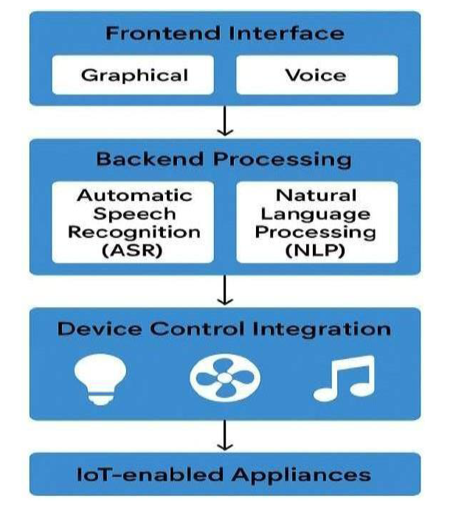
Architecture Diagram

Slide 9
Modules Explanation
1. Voice Command Module
Converts spoken user input into text and maps it to corresponding device control actions using speech recognition.
2. Accessibility Module (Audio/Visual Support)
Provides audio feedback for visually impaired users and visual alerts or pop-ups for hearing-impaired users to ensure inclusivity.
3. Device Control Module
Executes the user’s commands by turning devices ON/OFF or performing specific actions through simulated or IoT-based control.
13

Slide 10
4.Emergency Module
Detects emergency voice commands like “Help” and instantly sends alerts or notifications to caregivers or emergency contacts.
5. User Authentication Module
Manages secure login for users and caregivers, ensuring that only authorized individuals can access or control the system.
6. Database Management Module
Stores and retrieves essential data such as user profiles, device states, command history, and emergency logs securely.

Slide 11
Algorithm
Step 1: Speech Recognition (ASR): Converts speech → text.
Step 2: NLP Processing: Extracts action + device.
Step 3:Device Control Algorithm: Executes ON/OFF commands.
Step 4: Emergency Detection: Detects “Help” & alerts caregivers.
Step 5: Feedback Algorithm: Provides voice + visual confirmation.
Step 6: Emotional Support Algorithm: Responds to user mood.

Slide 12
Testing
Functional testing of each module
Verifies that every module (voice command, device control, emergency, feedback) performs its intended operation correctly without errors.
Voice Recognition Accuracy Test
Measures how accurately the system converts spoken commands into correct text and executes the right action.
Response Time Measurement
Evaluates how quickly the system responds after receiving a command until the action or feedback is completed.

Slide 13
Noise Tolerance Test
Tests the system’s ability to recognize commands accurately even when background noise or multiple sounds are present.
GUI Accessibility Test
Ensures the interface is usable for all users by checking features like large buttons, high-contrast visuals, and screen-reader compatibility.

Slide 14
Testcase/Validation
Test Case | Input | Expected Output | Result
Voice Cmd | “Light on” | Light = ON | Pass
Voice Cmd | “Fan off” | Fan = OFF | Pass
Emergency Cmd | “Help” | Alert Sent | Pass
Invalid Cmd | “Dance” | “Command not recognized” | pass

Slide 15
Performance Analysis
Voice Accuracy: 93% (normal), 87% (noisy)
Average Response Time: 1.2 s
Emergency Response: < 1 s
Resource Use: CPU 20–25%, RAM ~150 MB
User Satisfaction: 92% positive feedback

Slide 16
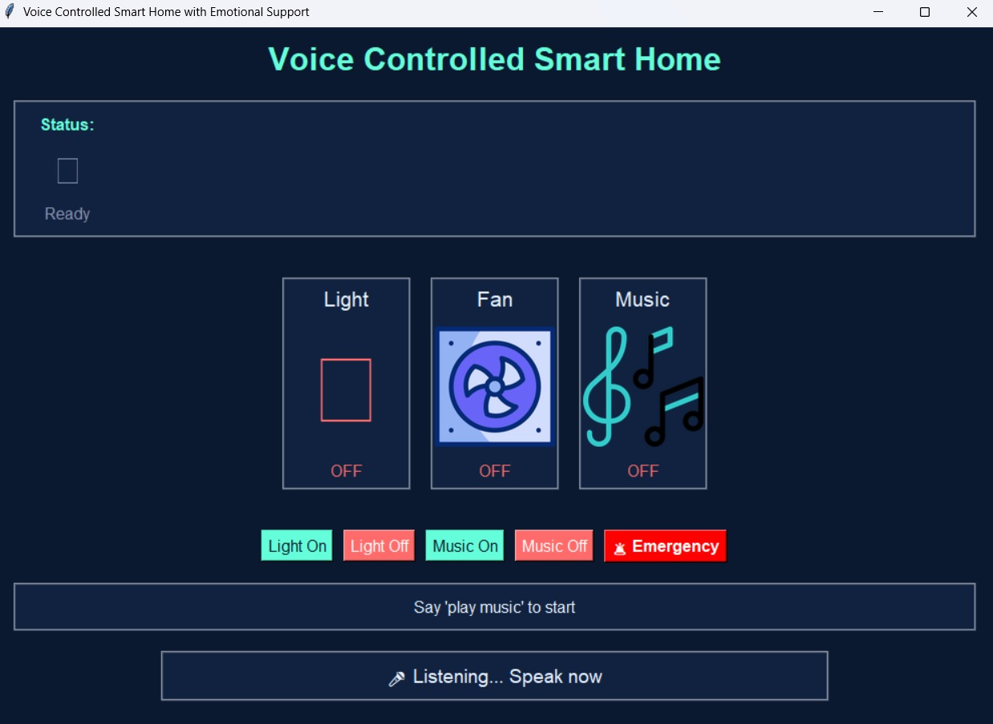
Screenshot
19

Slide 17
Conclusion
Successfully developed inclusive smart home software
Enables independence for disabled individuals
Voice + Visual + Emergency control modules integrated
Low-cost, scalable, and reliable
25

Slide 18
Future Work
Integration with real IoT devices (Arduino, ESP32)
Multilingual command support
Cloud data synchronization
AI-based personalization
Wearable device integration

Slide 19
Reference
S. A. Omer et al., “IoT-Based Smart Home System for Disabled People,” IEEE Access, 2024.
A. Gupta, “AI-Based Smart Home System for Differently Abled People,” SpringerLink – Lecture Notes in Networks and Systems, 2024.
S. Sharma et al., “IoT-Based Assistive Smart Home Automation System,” arXiv preprint, 2025.
O. Turgut et al., “Smart Homes for Disabled People: IoT and AI Integration,” ResearchGate, 2024.
Ultralytics, “YOLOv8 Object Detection for Smart Home Vision Systems,” Documentation, 2025.
27

